Slide 1

2027 Benefits

Slide 2


2027 Open Enrollment
Starts October 1st, 2026, and
ends October 31st, 2026
Open Enrollment 2027

Slide 3
It’s Open Enrollment
Decisions you make during Open Enrollment affect your benefits for January 1, 2027, through December 31, 2027
Be Prepared: Mark your calendar and involve your spouse/partner Be Informed: Read your enrollment information
Be Involved: Learn how your benefits work
The deadline to submit open enrollment forms to your Human Resources Representative is October 27, 2026
Open Enrollment 2027

Slide 4

Who you can cover
Dependents
Spouse or qualified domestic partner
Natural, adopted or stepchildren up to age 26
Domestic partner’s children are eligible up to age 26
Disabled dependent children over age 26
Children named in qualified medical child support order (QMCSO)
Open Enrollment 2027

Slide 5
Special Enrollment Opportunities
During Open Enrollment employees may:
Change medical plans, enroll in a new plan
Add or drop dependent coverage Cancel coverage
Re-enroll in flexible spending accounts (FSAs)
Changes are allowed within 60 days of a qualifying life event, such as:
Change in marital status; eligible domestic partner; minor child requiring health coverage Newborn or adopted child
Losing or gaining other health coverage
Moving out of plan service area
Open Enrollment 2027

Slide 6
What’s New or Changing for 2027?
Summary
Carrum Program Expansion – Anthem PPO
Effective 07/01/2026 Carrum now offers comprehensive substance use disorder treatment and support. Including detoxification, residential treatment, partial hospitalization, intensive outpatient treatment, and outpatient/virtual care for substance use. ​
Anthem PPO GLP-1 Changes​
Effective 01/01/2027 GLP-1 medication for weight loss will no longer be covered under PPO plans. Coverage for type 2 diabetes remains in place. ​
Digbi Health Service Update​
Due to changes to GLP-1 availability on PPO plans, Digbi will continue their “Food as Medicine” program but will no longer offer weight management with GLP-1​.
Open Enrollment 2027

Slide 7
What’s New or Changing for 2027?
Summary
Costs are Changing
HDHP I Deductible is increasing​
FSA, HSA, and Dependent Care maximums have changed​
NEW! Voluntary Legal Plan, Pet Insurance, EAP, Life with Long-Term Care​
Open Enrollment 2027

Slide 8
Enrolling for Benefits - Benxcel Self Service
Visit: benxcel.net
Username: the first two letters of your first name, the first two letters of your last name, the last four of your SSN (ex: Mary Smith’s SSN of 123AB1234 = masm1234)
Default password: Enter your initial password: the first four numbers of your SSN and your full date of birth in MMDDYYYY format
(ex: SSN of 123AB1234 and full DOB of 12/13/1950 = 123A12131950)
Enter the Company Name: CSURMA
Click the Sign In button to enter the system
Open Enrollment 2027

Slide 9

Enrolling for Benefits - Benxcel Self Service
If you are not planning to make any changes to your benefits, you don't need to log on to our benefits enrollment system. Your current benefits will carry over, except for flexible spending accounts, which FSA participants must reenroll in every year.
If you want to make new elections, change your benefits, enroll in a healthcare or dependent care flexible spending account, you will need to log on to the system. In these cases, you should take action accordingly.
Remember that your benefits will carry over if you don't make any changes.
Open Enrollment 2027

Slide 10

Medical Health Plans
What’s New or Changing for 2027? Employee cost is changing.

Slide 11
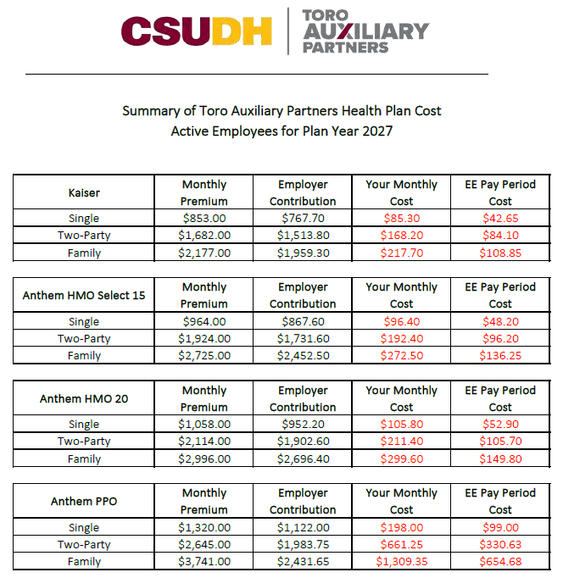
Active Employee Health Cost and Medical Plan Summaries
Health Plan Cost - Active Employees 2027
Anthem HMO 15 Plan Summary
Anthem HMO 20 Plan Summary
Anthem PPO 80 Plan Summary
Kaiser HMO $15 Plan Summary
Kaiser Chiropractor Benefits Summary
Open Enrollment 2027

Slide 12
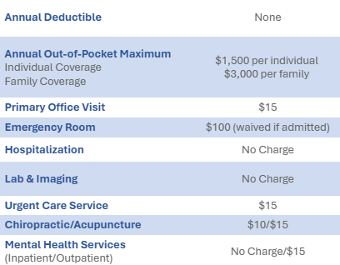

Kaiser Plan Summary
Kaiser HMO $15 Plan Summary
Prescription Plan

Slide 13
Resources for Kaiser Members
KAISER PERMANENTE
KP on Call | Look for after hours nurse advice information on the back of your ID card. Speak with a licensed health care professional by phone for health questions, and advice about seeking medical care.
Kaiser Away from Home | Kaiser Members are covered for emergency and urgent care anywhere in the world. Kaiser’s travel website will explain what to do if you need emergency or urgent care during your trip.
Target Retail Clinics | Target Clinics offer care provided by Kaiser Permanente for more than 85 different services, including treatments for common health conditions and minor injuries. The clinics are open 7 days a week for appointments and walk in care. Find a clinic near you using kptargetclinic.org.
One Pass | One Pass is a subscription-based membership to help members meet their health goals. Visit youronepass.com and click get started.
myStrength | The myStrength app is designed to help navigate life’s challenges, make positive changes, and support your overall well-being. The app can help you set goals and work towards them in the ways that work best for you. You can access myStrength at kp.org/selfcareapps and choose the mental health and wellness areas you want to focus on.

Slide 14
Resources for Kaiser Members
KAISER PERMANENTE
Calm App | The Calm app uses meditation and mindfulness to help lower stress, reduce, anxiety, and improve sleep quality. Adult members can get Calm at kp.org/selfcareapps .
Headspace | Get help with sleep, stress, focus, and more. With hundred of self-guided resources along with one-on-one coaching. kp.org/selfcareapps
Online wellness tools | Visit kp.org/healthyliving for wellness information, health calculators, fitness videos, podcasts, and recipes from world class chefs. Connect to better health with programs to help you lose weight, quit smoking, and more – all at no cost.
Health classes | Sign up for health classes and support groups at many of our facilities. See what’s available near you at kp.org/classes – some may require a fee.
Personal wellness coaching | Get help reaching your health goals. Work one on one with a wellness coach by phone at no cost. Find out more at kp.org/wellnesscoach.
ChooseHealthy member discounts | Members get reduced rates on a variety of health-related products including Acupuncture, Massage Therapy, Chiropractic Care, and Gym Memberships. Visit kp.org/choosehealthy to learn more.

Slide 15
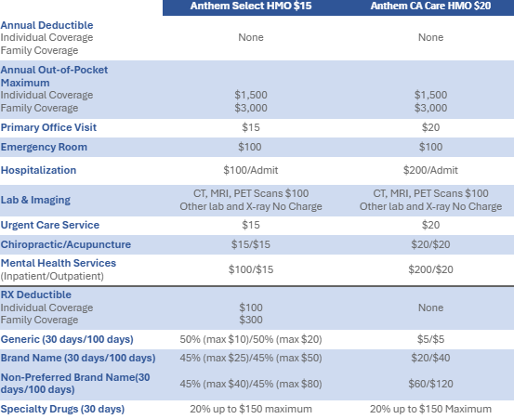
Anthem Select HMO $15 & HMO $20 Plan Summaries
Anthem HMO 15 Plan Summary
Anthem HMO 20 Plan Summary

Slide 16
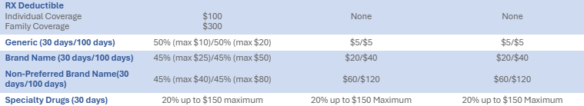
Anthem Select HMO $15 & HMO $20 Prescription Plan
Anthem HMO 15 Plan Summary
Anthem HMO 20 Plan Summary

Slide 17
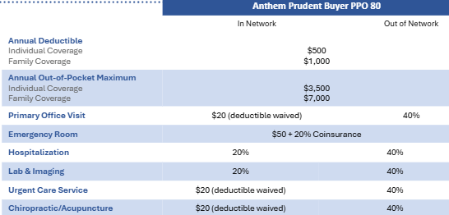
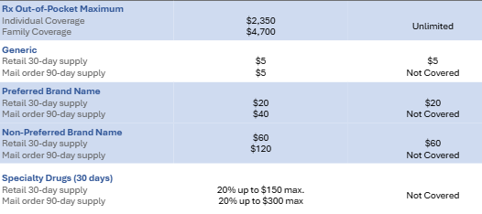
Anthem PPO 80 Plan Summary
Anthem PPO 80 Plan Summary
Prescription Plan

Slide 18
Prescription Drugs - Navitus
Anthem members have access to prescription drug coverage through Navitus.
Network Pharmacy – Most independent and all major chain pharmacies, are part of your benefit network.
Costco Mail Order – A 90-day supply of maintenance medications can be mailed right to your door. You don’t need to be a Costco member to use their pharmacies.
Specialty Pharmacy - Lumicera Health Services provides a high level of personalized care for members with complex conditions.
Simplifying Prior Authorization, Step Therapy & Exception to Coverage - There are certain conditions and medications which require extra steps to gain approval to fill the prescription, but Navitus tries to make it as easy as possible.

Slide 19
Prescription Drugs - Navitus
Navitus manages pharmacy benefits for all Anthem members. Members can access the member portal by visiting the site to get more information about coverage, drug prices, and medication history.
Member Portal & App
Go to navitus.com/members to access the member portal or download
the Navitus mobile app to access:
ID card
Coverage details
Drug prices & pharmacy locations
Your medication history

Slide 20
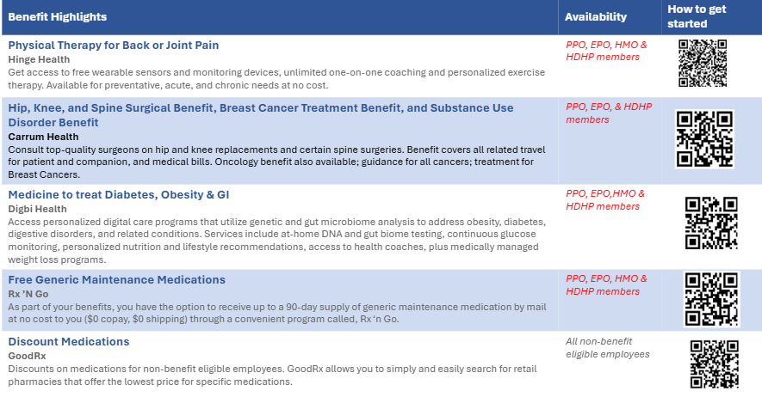
Anthem Value Added Services

Slide 21
Resources for Anthem Members
Anthem Blue Cross
Sydney Mobile App | Use SydneyTM Health to keep track of your health and benefits- all in one place. Access your plan details, Member Services, virtual care, and wellness resources. You can also set up an account at anthem.com/ca/register to access most of the same features from your computer.
Building Healthy Families | Building Healthy Families offers personalized, digital support through the SydneySM Health mobile app or on anthem.com/ca. This all-in-one program, at no extra cost to you, can help your family grow strong whether you’re trying to conceive, expecting a child, or in the thick of raising young children.
Livehealth Online | Visit with a board-certified doctor using your smartphone, tablet or computer with a webcam. Doctors are available 24/7 to assess your condition and, if it’s needed, they can send a prescription to your local pharmacy. Register online and download the mobile app.
24/7 Nurse Line | 24/7 NurseLine serves as your first line of defense for unexpected health issues. You can call a trained, registered nurse to decide what to do about a fever, give you allergy relief tips, or advise you where to go for care. For help, look on the back of your ID card to call 24/7 NurseLine.
Anthem Total Health Select | a new platform to help you navigate benefits, coordinate care, and access well-being resources for Anthem PPO/EPO/HDHP Members . Register for the Sydney app anthem.com/ca/register to access.

Slide 22
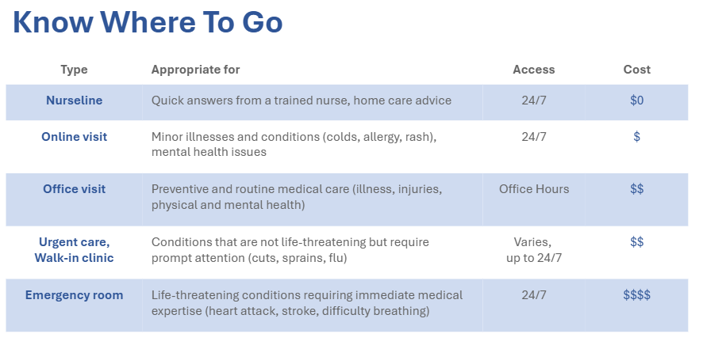
Engage With Your Health

Slide 23
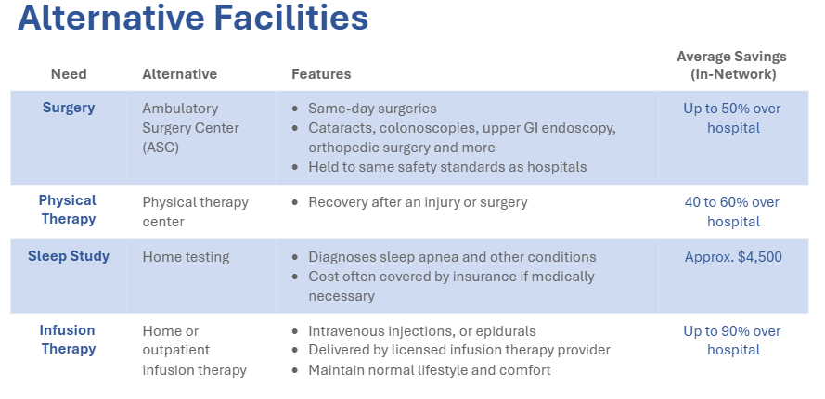
Engage With Your Health

Slide 24
Engage With Your Health
Preventive care
Preventive care is 100% covered in-network
Preventive care = annual exam and lab tests to monitor health and detect potential issues
Not all exams and tests are considered preventive
Check with your health plan if you have questions
Typical Screenings for Adults
Blood pressure
Cholesterol
Diabetes
Colorectal cancer screening
Depression
Mammogram
OB/GYN screening
Prostate cancer screening
Testicular exam

Slide 25

Engage With Your Health
Prescription Drugs
Money-saving tips
Always ask your doctor if a generic drug is available.
Check the plan’s formulary (approved drug list). Visit the plan website or call Member Services.
Ask about a 90-day mail order supply for maintenance medications.

Slide 26
Dental and Vision

Slide 27

Dental and Vision
You may visit any office location that accepts your insurance for Dental (Delta Delta) and Vision (VSP).
To confirm coverage, please provide your personal information, including your Social Security Number.
There is no cost to employees for enrolling in dental or vision.

Slide 28
Delta Dental
Delta Dental Plan Summary PPO Plan B
Group # 19859
$1,500.00 Credit per person each calendar year
$50.00 Deductible per person each calendar year
No waiting period
Informational Links:
https://www1.deltadentalins.com/
https://www1.deltadentalins.com/members/find-a-dentist.html

Slide 29
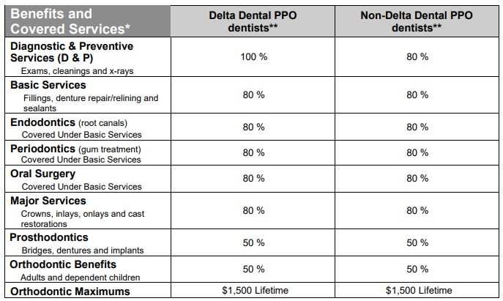

Delta Dental

Slide 30
Delta Dental Resources
Delta Dental
SmileWay® Wellness Benefits | If you or a covered family member has been diagnosed with a chronic medical condition like diabetes, cancer or rheumatoid arthritis, you may benefit from additional teeth and gum cleanings. your membership card. Opt in by visiting www.deltadentalins.com/smileway or by calling Customer Service Monday through Friday.
Delta Dental Mobile App | Anyone can use Delta Dental Mobile without logging in to access our Find a Dentist and Toothbrush Timer tools, conveniently located on the home screen. You also have the option to save your ID card to the home screen for easy access without logging in. Log into the app to view your personal benefits. Visit www.deltadentalins.com/members
Toothpic | Toothpic is a photo-based tele-dentistry app for PPO & premier plan members. Although Toothpic is not available for dental emergencies, members can set up a virtual dental screening or even send in photos for dental issues. A Delta Dental dentist that is part of the PPO & Premier Network, can highlight issues from the photos, such as cavities, gum disease, oral hygiene, or other dental concerns. The dentist can then assist with next steps or possible treatments or a home care regimen. Visit www.deltadentalins.com/members
Cost Estimator | Members can plan visits and compare costs before they receive their treatments. Estimates for each member are personalized based on benefits. Members can compare procedure costs at nearby dentists should members need to plan in terms of costs. Members can also receive a detailed explanation of their costs based on upcoming treatment. Visit www.deltadentalins.com/members
Amplifon & Qualsight Discounts | With the Amplifon discount, Delta Dental members get savings at the latest retail hearing aid price. PPO members may even be able to use their plan benefits in coordination with Amplifon discounts visit www.amplifonusa.com/deltadentalins . There is also a QualSight discount for Delta Dental members. Members receive a discount off the national average price of traditional LASIK eye surgery when you use an experienced QualSight LASIK surgeon visit www.qualsight.com/-delta-dental .
LifePerks | Wellness is more than oral health, that’s why Delta Dental members have access to a wide variety of local and national offers and discounts to help you care for your whole body and maintain a healthy life. Visit www.lifeperksml.lifemart.com

Slide 31
VSP Vision
VSP Vision Plan Summary Plan A with Tints
$10.00 copay for exams and glasses
$140.00 frame allowance every 24 months
$130.00 allowance for contacts every 24 months
Informational Links: https://www.vsp.com/ https://www.vsp.com/eye-doctor
Plus, these extra benefits:
Discounts on the Second pair of computer, reading, or prescription glasses and sunglasses.
Discount on laser vision correction

Slide 32
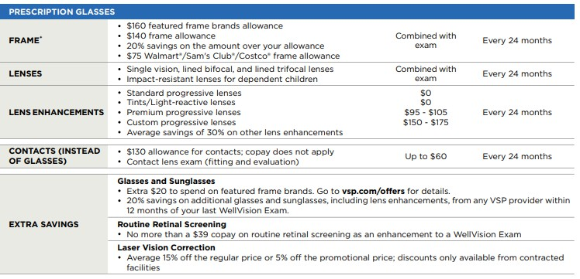

VSP Vision

Slide 33
Flexible Savings Account (FSA)

Slide 34
Healthcare Flexible Spending Account (FSA)
Five reasons to consider an FSA
Tax-free account for healthcare expenses.
Pay for eligible healthcare expenses including office visits, lab tests, dental and vision care, prescriptions, over-the-counter medicines.
Funds can be used on your spouse or tax dependents even if they are not on your health plan.
Funded by pre-tax contributions from your paycheck—up to $4,400 per year*.
Funds are available on the first day of the plan year!
USE IT OR LOSE IT – Grace Period : All claims must be submitted by March 31st for the prior plan year.

Slide 35
Healthcare Flexible Spending Account (FSA)
Is it right for me? It is if you …
Want to save on taxes and medical expenses
Can estimate the healthcare expenses you expect your family to have from January 1st, 2027, through December 31st, 2027
Do not have a healthcare spending account (HSA) (limited purpose FSA allowed with HSA)
Can commit to payroll deductions for the coming year (your total election divided by 26 for each pay period)
The 2027 contribution limit is $4,400 (2027 amounts haven’t been released yet)

Slide 36
Healthcare Flexible Spending Account (FSA)
Common Eligible Expenses:
:
Acupuncture
Ambulance
Artificial limbs
Artificial teeth*
Birth control treatment
Blood sugar test kits for diabetics
Breast pumps, lactation
supplies
Chiropractor
Contact lenses and solutions*
Crutches
Dental treatments*
Doctor’s office visits and
copays
Drug addiction treatment
Drug prescriptions
Eyeglasses (Rx and reading)*
Fluoride treatments*
Hearing aids and batteries
Infertility treatment
Inpatient alcoholism treatment
Insulin
Laboratory fees
Laser eye surgery*
Menstrual care products
Orthodontics*
Orthotic inserts
Over-the-counter medications without a prescription
Prescription drugs
Speech therapy
Surgery, excluding cosmetic
Telehealth visits
Vasectomy
Vision exam*
Walker, cane, wheelchair

Slide 37
Healthcare Flexible Spending Account (FSA)
Common Ineligible Expenses:
:
Aromatherapy
Baby bottles and cups
Baby oil
Baby wipes
Cosmetics and skin care
Cosmetic surgery
Cotton swabs
Dental floss
Deodorants
Hair re-growth supplies & services
Health club membership dues
Humidifier
Lotion
Low-calorie foods
Mouthwash
Petroleum jelly
Shampoo and conditioner

Slide 38
Dependent Care Flexible Spending Account (FSA)

Slide 39
Dependent Care Flexible Spending Account (FSA)
A dependent care flexible spending account can help families save hundreds of dollars per year on day care. A dependent care FSA lets you set aside money from your paycheck, before taxes, to pay for work-related day care expenses. Eligible expenses include not only child care, but also before- and after-school care programs, preschool, and summer day camp for children younger than 13. The account can also be used for day care for a spouse or other adult dependent who lives with you and is physically or mentally incapable of self-care.
You can set aside up to $5,000 per household per year. It’s important to know that you can’t change your FSA election amount mid-year unless you experience a qualifying event. Money contributed to a dependent care FSA must be used for expenses incurred during the same plan year. Any remaining account balance will be forfeited. Also note that the account can only be used on eligible day care expenses. If you also have a healthcare FSA, there can be no crossover of funds. Talk to a tax advisor if you have questions about whether participating in the dependent care FSA will affect claiming a dependent care tax credit on your federal tax return.

Slide 40
Dependent Care Flexible Spending Account (FSA)
Three reasons to look into the Dependent care FSA
You pay for preschool, day care, before/after school programs, and/or summer day camp so you and your spouse can work.
How it works
Funded by pre-tax contributions from your paycheck—up to $7,500 per household per year
You have children under 13 and/or adult dependents who need day care.
Election is binding unless you have a change in status
You want to save on taxes.
Note: You must re-enroll every year
FSA aa tax advisor

Slide 41
Life and AD&D Insurance Hartford Life Insurance

Slide 42
Basic Life and AD&D Insurance Hartford Life Insurance
No one likes to think about a serious accident or illness, but it can happen at any age. Being prepared is the best way to ensure that you and your family will be able to preserve savings and pay for day-to-day living if something happens.
TAP employees are eligible for Basic Life and AD&D insurance.
Annual Salary capped at $75,000.00 pay out

Slide 43
Basic Life and AD&D Insurance Hartford Life Insurance
  If you were injured—or worse—would the most important people in your life, be protected financially? The company provides eligible employees with life and AD&D coverage.
  The life insurance benefit pays your beneficiary if something happens to you.
  The AD&D coverage pays a benefit in the event of your accidental death or covered injury.
  Don’t forget to designate a beneficiary who would receive the benefit. You can update your designation at any time should circumstances change.

Slide 44
Hartford Long-Term Disability (LTD)
Long-term disability replaces a portion of your income if you’re unable to work due to a disability lasting an extended period of time.
The plan pays a percentage of your monthly earnings up to a maximum benefit amount.
Benefits begin after a waiting period.
Take a moment to review this coverage.
Your benefit may be reduced by any state, federal, or private disability benefits you receive while disabled.
Refer to your benefits materials for more details.

Slide 45
Disability insurance – Hartford Life Insurance
Long Term Disability benefits are available after an elimination period (or waiting period) of total disability. Disability insurance helps replace a portion of lost wages while unable to work due to sickness or injury.
LTD Waiting Period | Benefit Perce ntage | Max Monthly Benefit | Minimum Monthly Benefit
90 Days | 60% of salary | $3,750 | The greater of $100 or 10% of the benefit based on Monthly Income Lost

Slide 46
Voluntary Benefits

Slide 47
Voluntary Benefits Overview
MetLife Pet Insurance
• Up to 90% reimbursement
• Optional preventive care coverage
• 24/7 telehealth access
• Coverage for eligible pre-existing conditions when switching providers
• Mobile app for claims and wellness tracking
MetLife Voluntary Legal Plan
$19.75 per month with coverage for family and dependents
• Help with estate planning, family matters, real estate, tax audits, traffic matters, and more
• Attorney consultations, document review, wills, trusts, power of attorney, and elder care support
• No copays, deductibles, wait times, or claims forms for covered services

Slide 48
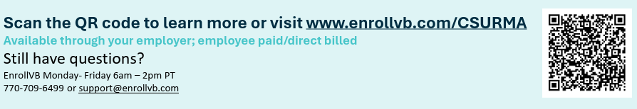
Voluntary Benefits Overview
Chubb Voluntary Life Insurance + Long-Term Care
• Rates vary based on age and selected coverages. Coverage is available for employees, spouses, and children.
• Portable coverage if you change jobs or retire
• Early access to death benefits for eligible long-term care expenses
• Premiums are guaranteed and will not increase through age 100*

Slide 49
Hartford Employee Assistance Program (EAP)

Slide 50
Hartford Employee Assistance Program (EAP)
The EAP is free for you and your household members through Ability Assist.
Help with emotional health, substance use disorder, parenting/childcare needs, financial coaching, legal consultation, and eldercare resources.
Unlimited phone access 24/7
In-person or video counseling for short-term issues (up to 3 visits per issue per year)
Unlimited access to website resources

Slide 51
Hartford Employee Assistance Program (EAP)
Phone: 1-800-964-3577
Website: guidanceresources.com
To register, follow the following steps:
                In the Company/Organization field, use: HLF902
                In the Company Name field, use: ABILI
                Select Username and Password

Slide 52
Hartford Travel Assistance Services w/ ID Theft Protection
The Hartford Travel Assist
The ID theft services are available to you and your family at home or when you travel.
Contact 1-800-243-6108
idtheft@europeassitance-USA.com
ID: GLD-09012
Company Policy: 402909

Slide 53
Hartford Travel Assistance Services w/ ID Theft Protection
Even the best planned trips can be full of surprises.
Travel Assistance Services with ID Theft Protection and Assistance include pre-trip information to help you feel more secure while traveling.
It can also help you access medical professionals across the globe for medical assistance when traveling 100+ miles away from home for 90 days or less, when unexpected detours arise.

Slide 54
Digital Behavioral Health Resource
TALKSPACE

Slide 55
Digital Behavioral Health Resources
There are times when everyone needs a little help or advice. The Talkspace platform provides digital behavioral health therapy and emotional wellness support to eligible employees and dependents at no cost.
Talkspace features include:
        Access to thousands of master’s level and higher, experienced, licensed and insured therapists.
        You can send unlimited text, video, and audio messages to your dedicated therapist via secure, HIPAA-compliant web browser or the Talkspace mobile app.
        No commutes, appointments, or scheduling hassles.
        Available 99.9% nationwide
        Extensive experience across an array of conditions
        Same-day access to therapy 24 hours a day, 7 days a week, 365 days
        One complimentary 10-minute video session

Slide 56
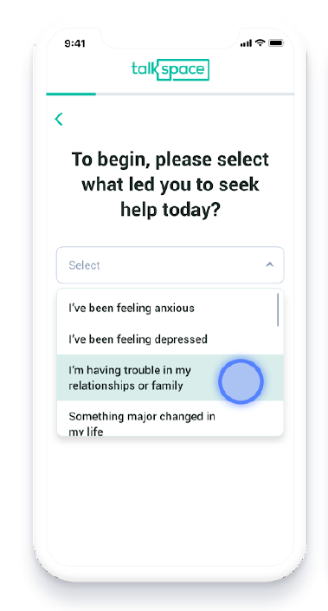
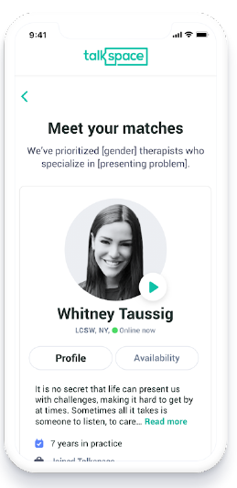
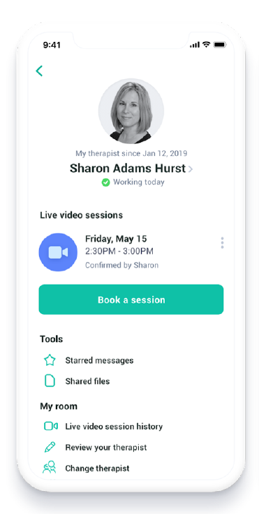
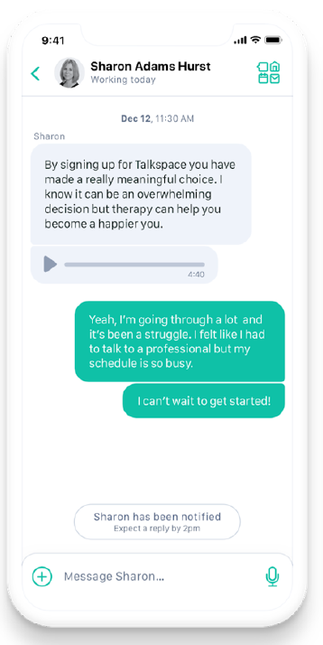
Talkspace
Mental Health Services Through Talkspace
        Video or phone consult with a provider anywhere, any time.
        To learn more and set up your account, go to talkspace.com/Alliant.
        When prompted enter the Organization Name, enter CSUDHFOUNDATION

Slide 57
Pathwise Financial Wellness

Slide 58
Pathwise Financial Wellness
What is the best way to pay off my student loan? How do I start saving or investing? Am I ready to retiree?
Sage Financial Wellness can help answer these questions!
Take an assessment
Access a Certified Financial Planner
Create a strategy and a financial plan
Receive year-round education and support
You can view or take the survey here: Launch Pathwise Portal

Slide 59
Questions?
Please contact your Human Resources Representative.
For Grants and Contracts: Martha Rafael Sepulveda
      Human Resources Director
      (310) 243-1070
For All other TAP Accounts: Megan Rousseau
Human Resources Generalist
(310) 243-3101

Slide 60
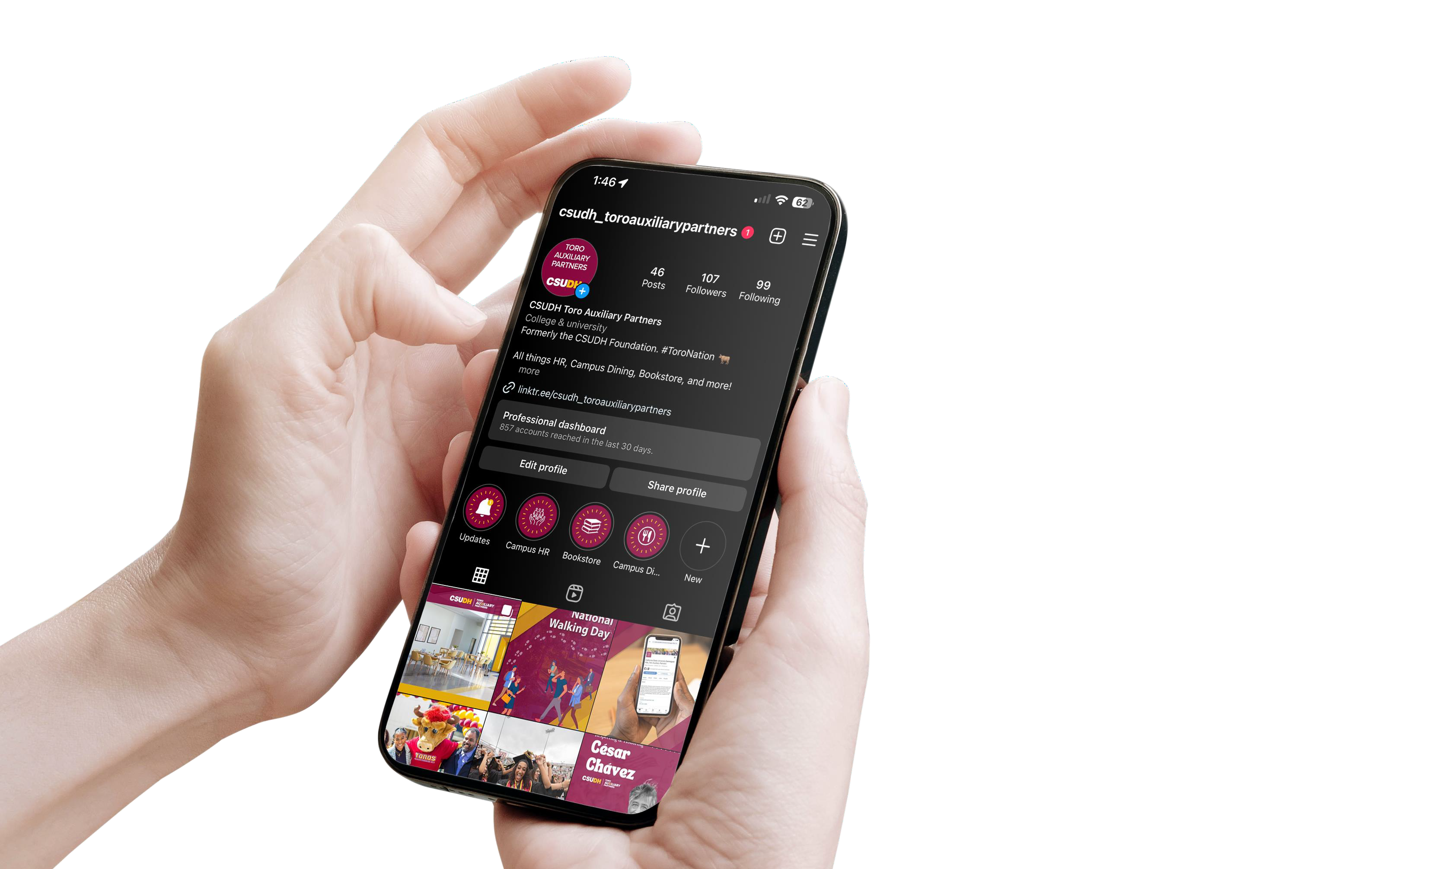

Follow us on Instagram @csudh_toroauxiliarypartners

